Slide 1
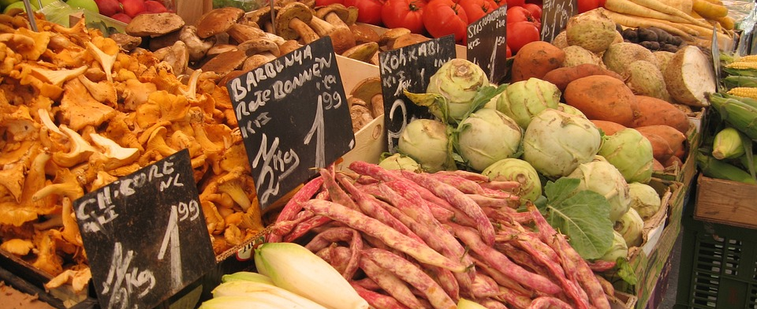
Report on Food Inflation Dynamics
By: Evan Hooper, Russel Ange, Rossi Wachacha, Layton Allen, Jackson Moseley

Slide 2
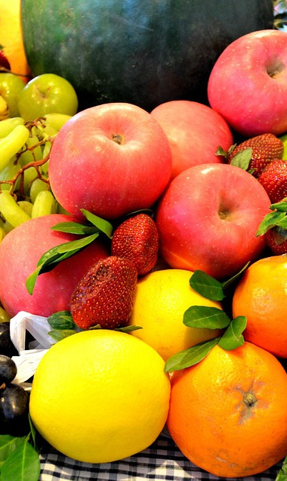
Objectives
First, we wanted to understand how expected producer prices (PPI) relate to expected consumer prices (CPI) across major food categories; in order to see how inflationary pressures move through the supply chain.
Second, we aimed to identify which CPI categories show the biggest differences between short-term (month-to-month) and long-term (year-over-year) inflation, helping us pinpoint areas of volatility that consumers are most likely to feel.
Third, we examined the accuracy and reliability of forecasted PPI prediction intervals compared to expected CPI values, to assess whether inflation forecasts realistically capture uncertainty and pass-through effects.

Slide 3
Methodology
Excel charts (historical trends): Showed long‑run CPI and PPI patterns, seasonal peaks, and how producer prices track consumer prices over time.
Tableau dashboards (forecast dynamics): Highlighted pass‑through strength across categories, volatility hotspots like beef and eggs, and CPI–PPI gaps.
Integrated insights: Combining Excel and Tableau revealed both historical context and forecast uncertainty, making inflation trends clear and actionable.

Slide 4
PPI to CPI Relationships
Strong pass‑through in beef & eggs: Excel line charts and Tableau dashboards show steep producer price increases mirrored in consumer prices, with volatility persisting into 2026.
Weaker links in pork & poultry: Tableau gap analysis highlights only modest CPI changes despite wholesale increases.
Muted or smoothed categories: Excel regression charts and Tableau dashboards show dairy, cereals, fats/oils, and produce with limited pass‑through, as retail smoothing keeps consumer prices stable even when farm‑level costs decline.

Slide 5
CPI Short-Term vs Long-Term Volatility
Beef & veal volatility: Excel tables show a 2.7% monthly increase, while Tableau dashboards reveal a much larger 13.9% annual rise, signaling strong momentum.
Egg instability: Excel data shows a slight monthly decline, but Tableau charts capture a double‑digit annual increase and a 31.7% year‑to‑date surge.
Category contrasts: Tableau comparisons highlight broader meats and beverages with notable short‑ vs long‑term gaps, while Excel and Tableau outputs confirm staples like dairy, cereals, and bakery products remain relatively steady.

Slide 6
Forecast Intervals and Reliability
Wide ranges in volatile categories: Tableau scatter plots and Excel tables show cattle and eggs with the broadest prediction intervals, reflecting structural shocks.
Partial pass‑through: Excel forecasts for cattle span 18–27% in 2025, while Tableau plots show CPI beef rising only ~9.5%, evidence of retail smoothing.
Moderated volatility in eggs: Excel projects extreme ranges (23–61% in 2025, –76 to 127% in 2026), but Tableau visuals confirm CPI eggs track the same direction at smaller magnitudes, showing consumer markets buffer households from full producer swings.

Slide 7
Key Findings
Uneven pass‑through: Excel forecast tables and Tableau dashboards show beef and eggs with strong producer‑to‑consumer transmission, while dairy, cereals, and produce remain muted due to processing and retail smoothing.
Volatility concentrated in proteins: Tableau short‑ vs long‑term CPI charts highlight beef and eggs as highly unpredictable, with wide forecast ranges in Excel and moderated CPI midpoints confirming partial pass‑through.
Retail smoothing effects: Excel multi‑year bar charts and Tableau dashboards on fruits and vegetables show farm‑level swings but stable consumer prices, underscoring how retail dynamics buffer households from extreme shocks.

Slide 8
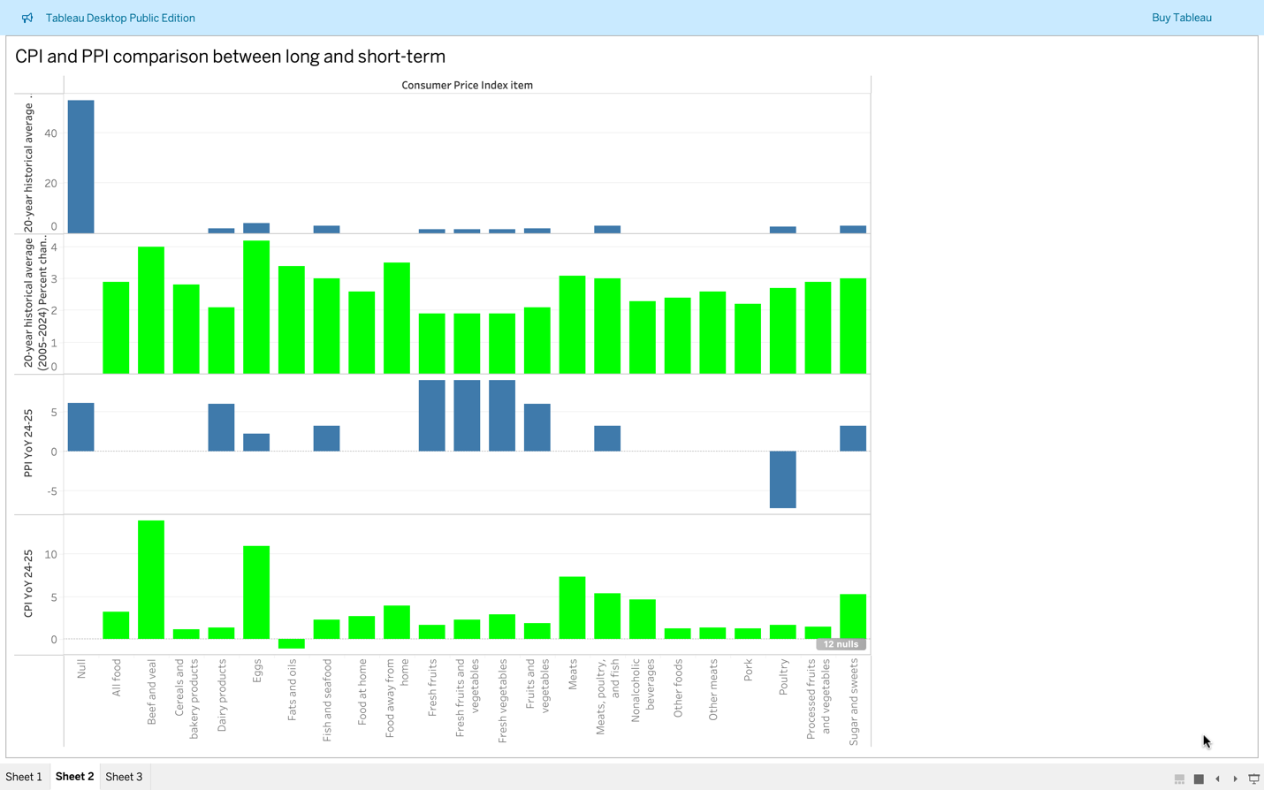
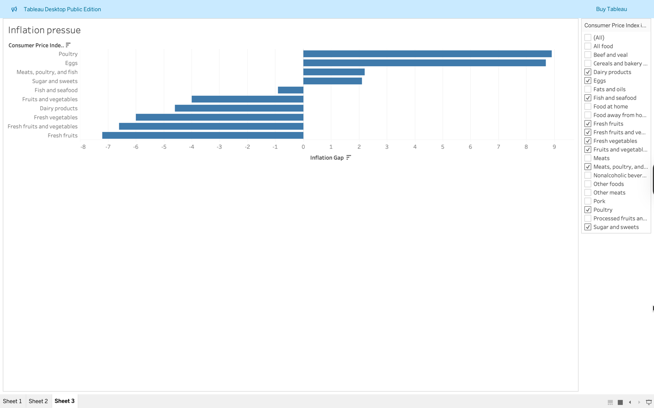
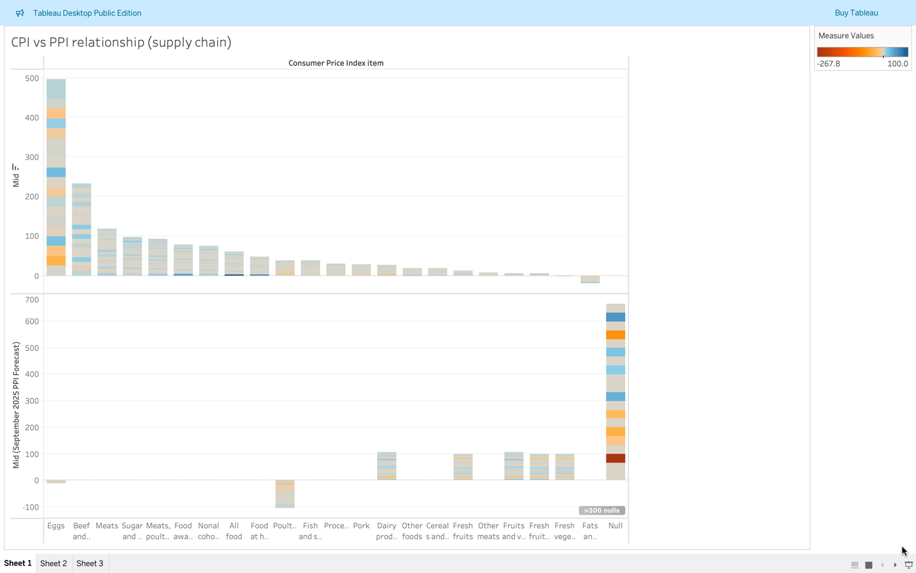
Tableau Charts

Slide 9
Excel Charts

Slide 10
Conclusion
Integrated approach: Excel forecast tables and Tableau dashboards together provide a structured view of inflation dynamics across the food supply chain.
Key insights: Excel charts quantified historical trends and forecast ranges, while Tableau visuals highlighted pass‑through strength, volatility hotspots, and CPI–PPI gaps.
Practical framework: Findings show where producer costs most affect consumers, how volatility is moderated, and offer guidance for policymakers, retailers, and households to anticipate and manage inflationary pressures.

